Slide 1
Exploratory Data Analysis Hotel Booking Data Analysis Project
Mentor: Munna Pandey
submitted by: S. Pratheek
Wave number:4777
Batch Number:da374S37

Slide 2
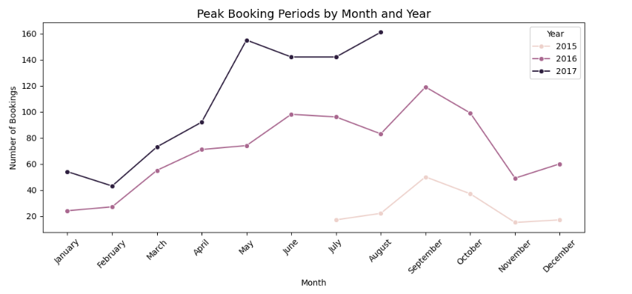
Booking Pattern Analysis
What are the peak booking periods for the hotel?
Interpretation:
I have analyzed the booking columns like arrival_date_year and arrival_date_month to find peak booking periods. by sorting the month to visualize and then I used advanced line plot for visualization. Peak booking period at the year of 2015 was in the month of September, at the year of 2016 peak booking period was in the month of September and at the year of 2017 peak booking period was in the month of May.

Slide 3
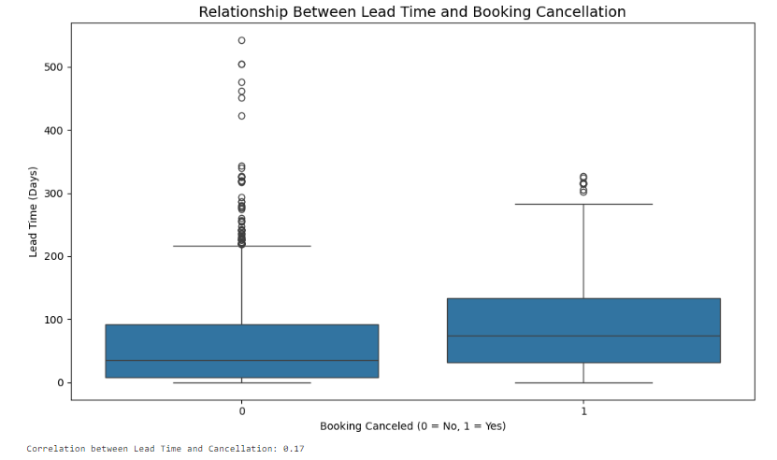
.
II. Is there a relationship between lead time and the likelihood of a booking being cancelled?
Interpretation:
In this task to find the relationship between lead time and likelihood. I have used both columns and then i used corr function for the relationship and visualized using boxplot. Correlation values is 0.17

Slide 4
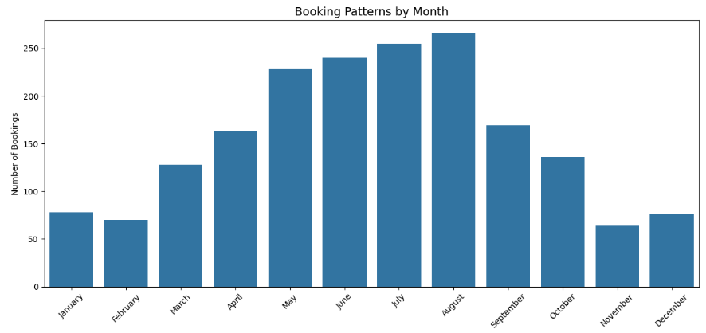
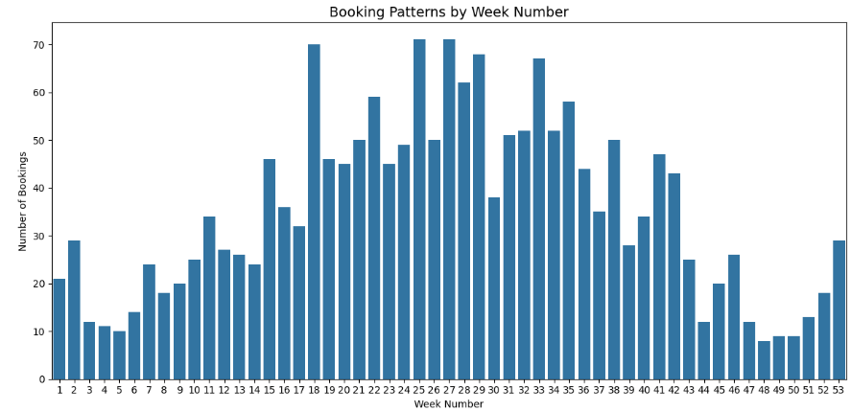
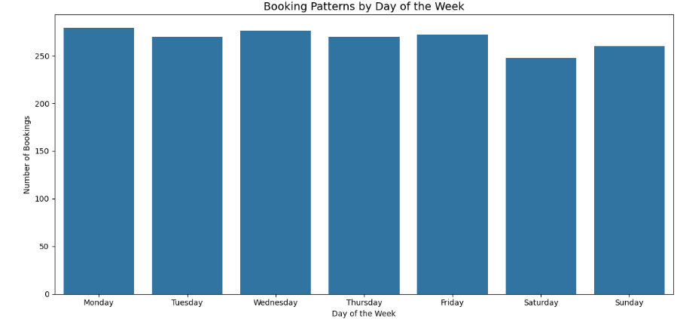
.
III. How do booking patterns vary by month week and day of the week?
Interpretation: I used count plot to visualize the
booking pattern vary by day, month and week.
In monthly August is peak, in day Monday is peak and in
week 25th week is in peak for booking.

Slide 5
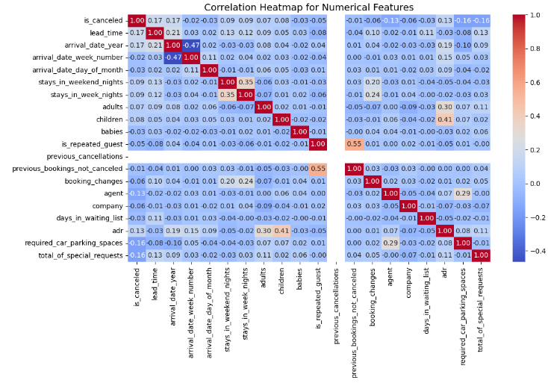
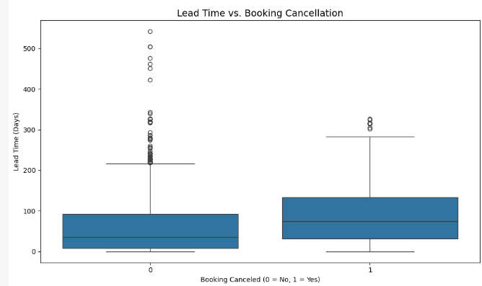
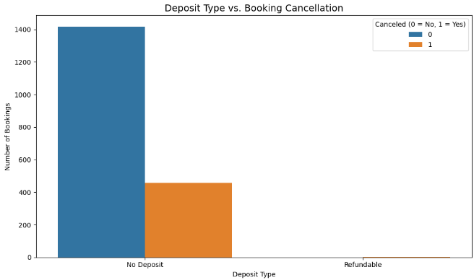
Booking Cancellation Analysis
What factors influence booking cancellations?
Interpretation: In this task using heatmap it shows positive
relationship with booking cancellation. The boxplot longer lead
times are associated with a higher likelihood of cancellations.
The count plot most cancellations occur with bookings that
have no deposit.

Slide 6
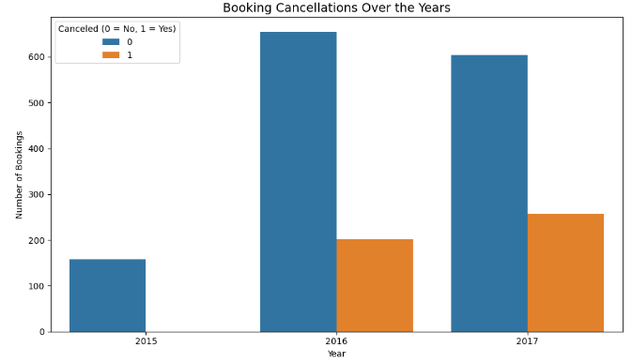
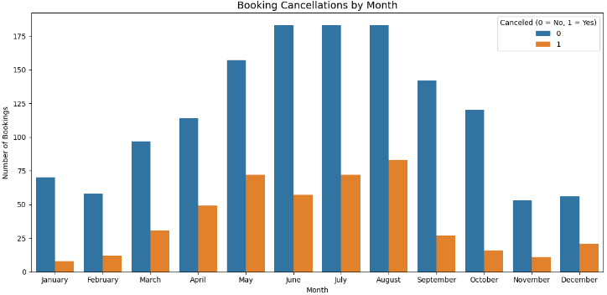
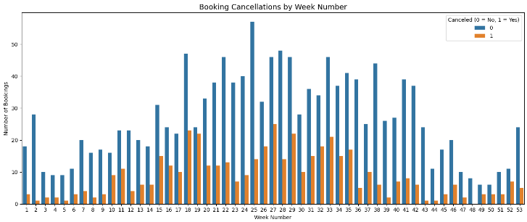
.
Are there specific trends or patterns in cancellations over time?
Interpretation:
In this task i found specific trends using count plot
I has identified that the year 2016 is in peak.
Using count plot by specific trend in month August is in
peak. Using week 25th week is in peak.

Slide 7
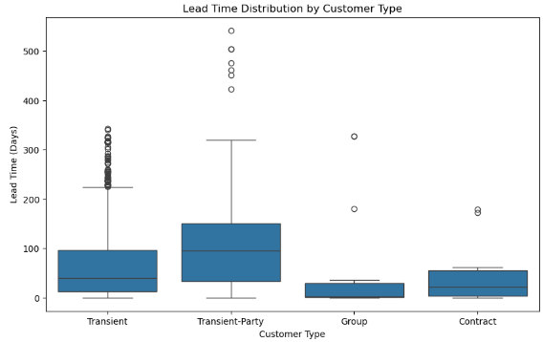
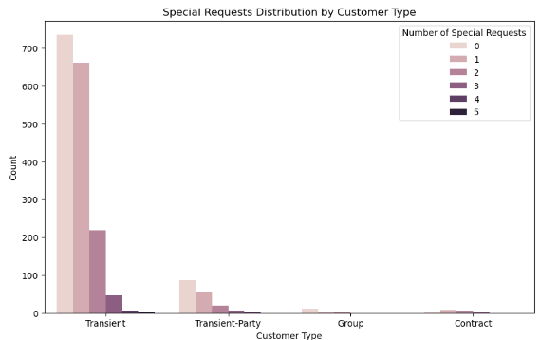
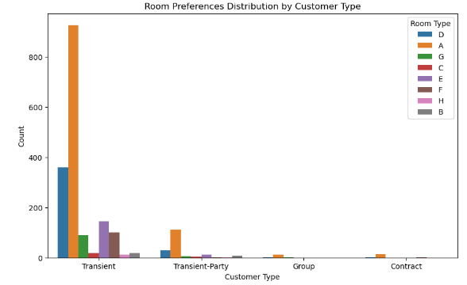
Customer Behavioral Segmentation
Are there distinct patterns in the lead time, special requests, or room preferences for different customer segments
Interpretation:
In this task using boxplot for lead time I identified customer type Transient-party book for longer.# count plot with special request Transient customer type is longer for booking. Count plot for room preference I has identified that Transient customer type is give more preference.

Slide 8
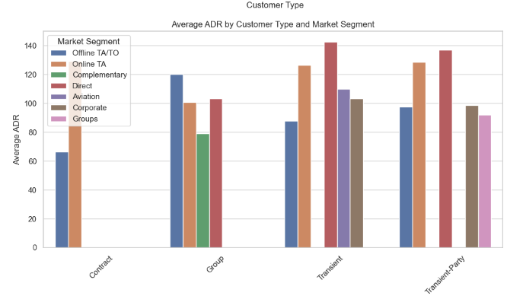
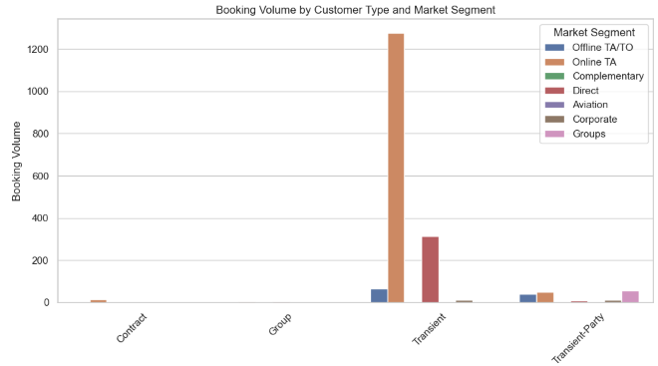
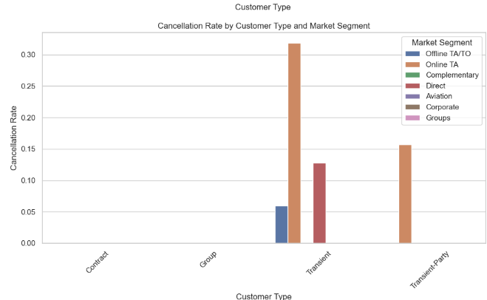
.
Which marketing channels are the most effective for reaching specific customer segments?
Interpretation: In this task to find the market channels to find the
most effective for specific customer segment .I used bar plot to
visualize the Booking Volume by Customer Type and Market
Segment,verage ADR by Customer Type and Market Segment and
Cancellation Rate by Customer Type and Market Segment.
So finally Online TA is this highest in market segment.

Slide 9
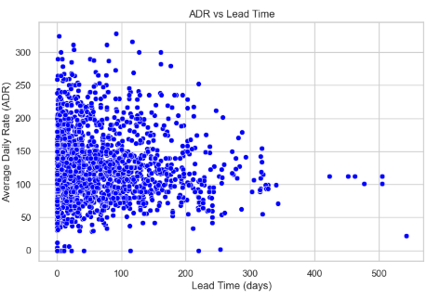
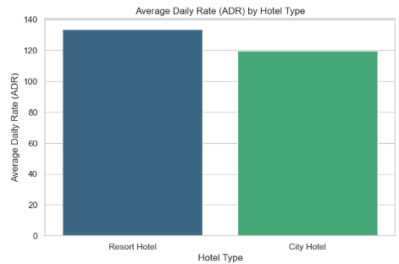
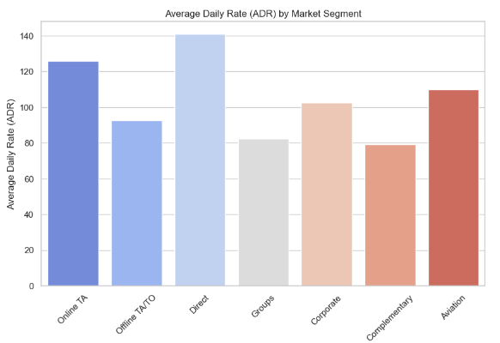
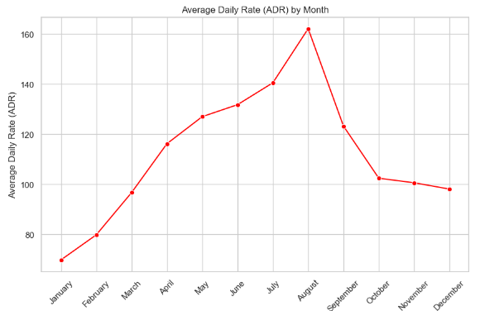
Revenue Management
Can we identify pricing strategies that maximize revenue?

Slide 10
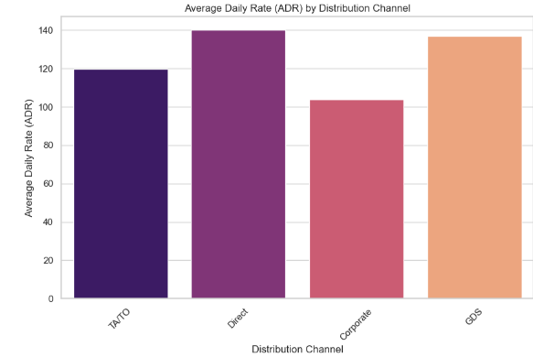
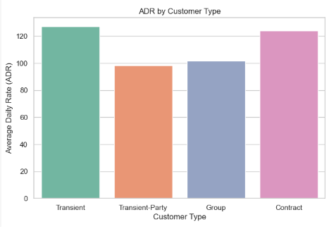
.
Interpreatation:
To identify pricing strategies that maximise revenue I used different advanced chart for visualization First chart is bar chart it will analyze ADR by hotel type so that Resort is highest in revenue,secondly scatterplot to visualize Analyze ADR vs Lead Time and it shows negative relationship(-0.0903234541920684) Third one is lineplot it analyze Seasonality - ADR by Month and visualization says that month of August is peak, and fourth will be barchart so it shows Impact of Market Segment on ADR,by visulization market segment'Direct' is in peak,in fifth chart (barplot) it shows Impact of Distribution Channel on ADR,by visualization distribution channel 'Direct' is in peak,finally Impact of Customer Type on ADR,by visualization the customer type Transient is in peak. Based on the analysis, we can finally say that pricing strategies that maximize revenue can be identified by focusing on high-revenue segments such as resorts,direct market segments, direct distribution channels, and transient customer types, particularly in peak periods like August.

Slide 11
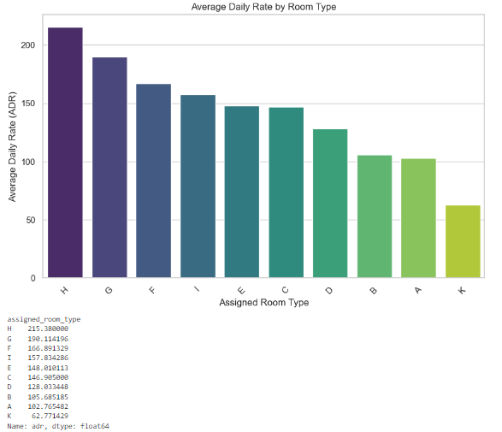
.
Are there specific room types associated with higher ADRO
Interpretation: In this task the count plot is used to find
specific room type with higher adro H has high ADRO

Slide 12
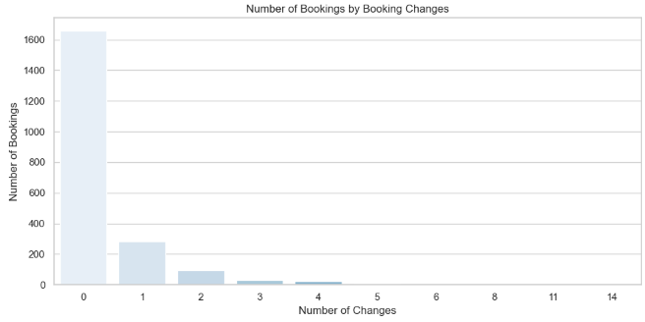
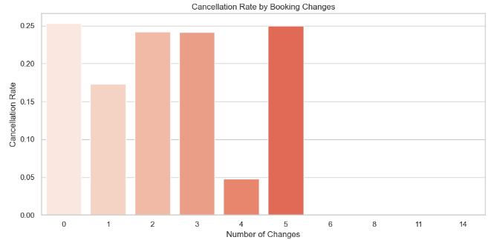
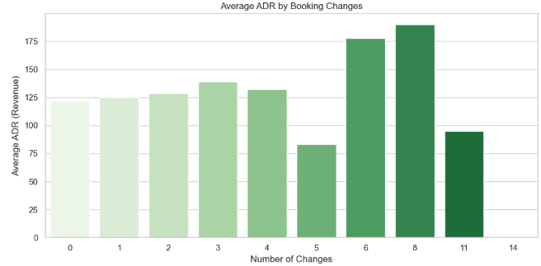
Operational Efficiency
How do booking changes impact hotel operations?
Interpretation:
From below bar graphs. The most booking have no changes(0),
Bookings with more changes show a higher likelihood of
Cancellation ,indicating instability in plans and finally with
ADR by booking changes ,when number of booking changes
is increase ADR is decrease. So it leads to revenue loss
if this cause frequently.

Slide 13
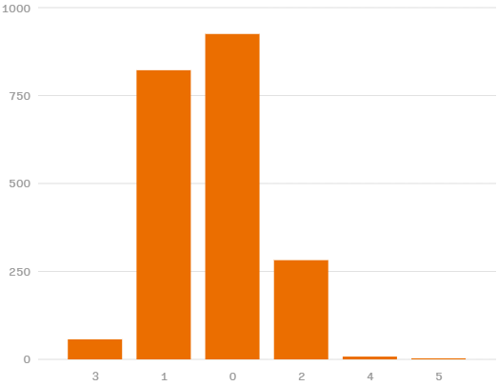
Customer Satisfaction
What is the distribution of the number and types of special requests made by guests?
Interpretation:
The type 0 have more number of special requests

Slide 14
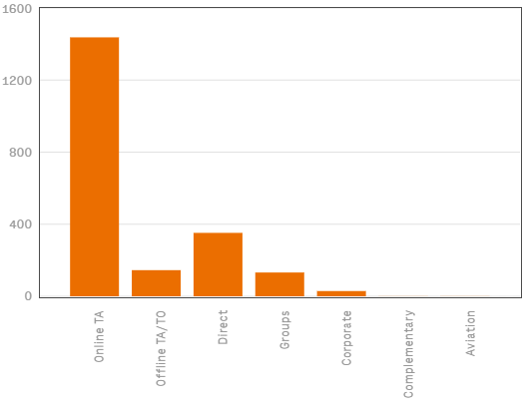
Marketing and Sales Optimization
Which marketing channels and market segments contribute the most to successful bookings?
Interpretation:
The online TA contribute the most in successful bookings

Slide 15
Conclusion & summary
Peak booking periods were in September 2015 and 2016, and May 2017.
Analyze recent data to identify any shifts in peak booking times.
A weak positive correlation (0.17) exists between lead time and likelihood.
Explore additional factors that might influence booking likelihood beyond lead time.
The Booking Patterns August is the peak booking month.Mondays are peak booking days. Week 25 is the peak booking week.
Cancellation Analysis Longer lead times are associated with higher cancellation rates.Deposits. Bookings without deposits have higher cancellation rates.Room Changes: Frequent room changes may increase cancellation risk.
Customer Segment Analysis Market Online Travel Agencies (OTAs) are the most effective market segment. Customer Type: Transient-party customers book for longer durations and have higher special request rates.Room Preference: Transient customers have specific room preferences.
The Room Type H has the highest Average Daily Rate (ADR).
The Booking Changes with more changes have higher cancellation rates and lower ADRs.
The Special Requests Room type 0 receives the most special requests.
Overall Recommendation
Regularly analyze booking data to identify emerging trends and adjust strategies accordingly.

